Slide 1



EduBot: A Voice-Driven Conversational AI for University Support System
Roshni Pal
^{Committee Chair: Dr. Long Jiao} Committee members: Dr. Ashokkumar Patel, Dr. Yuchou ^{Chang}
Master's Thesis in Data Science
University of Massachusetts, Dartmouth
August 4th , 2025

Slide 2

Introduction & Motivation

Slide 3
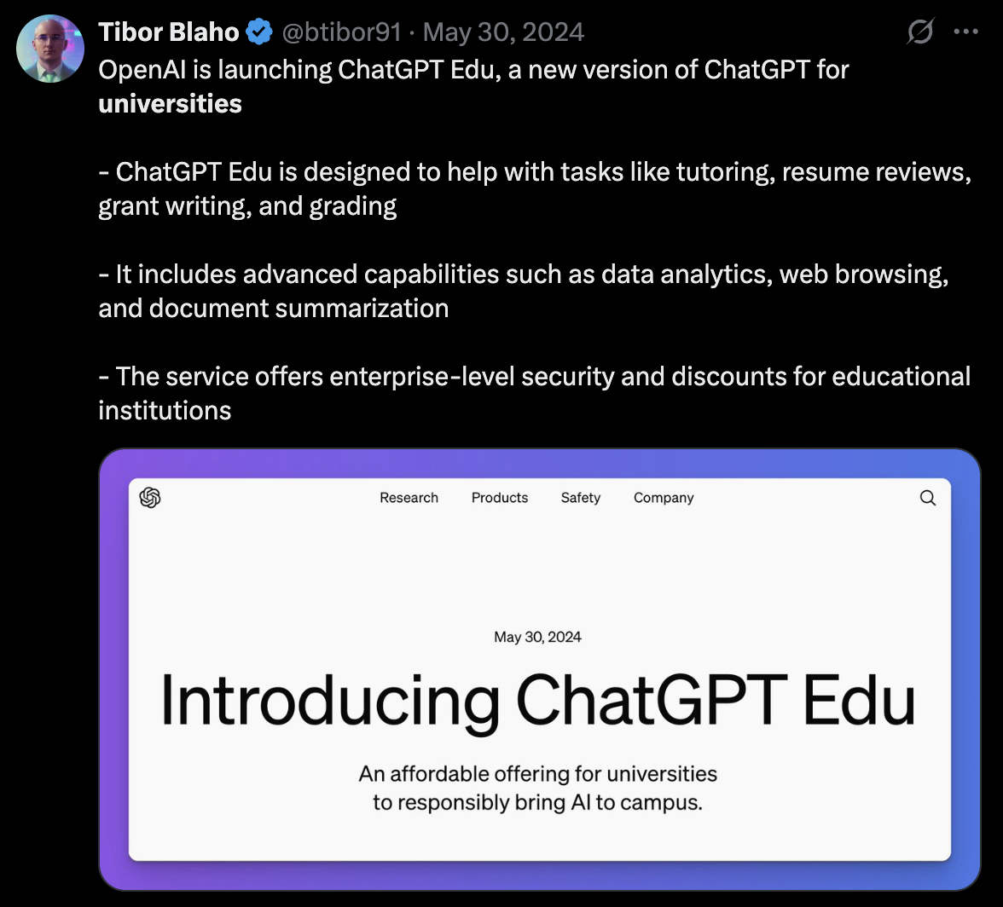
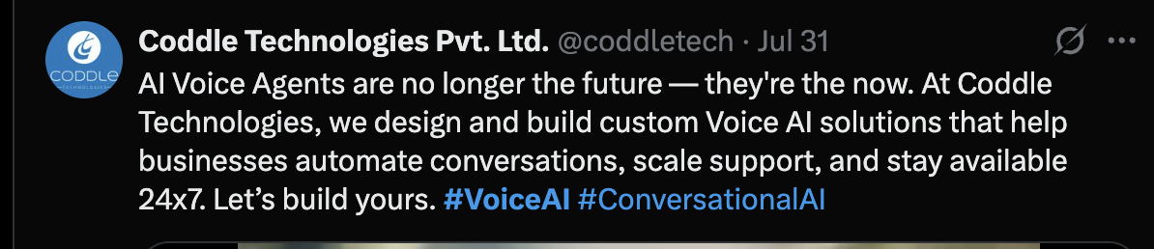
Background
AI is entering classrooms, but voice tools lag.
The need for 24x7 academic voice assistants is rising.

Slide 4
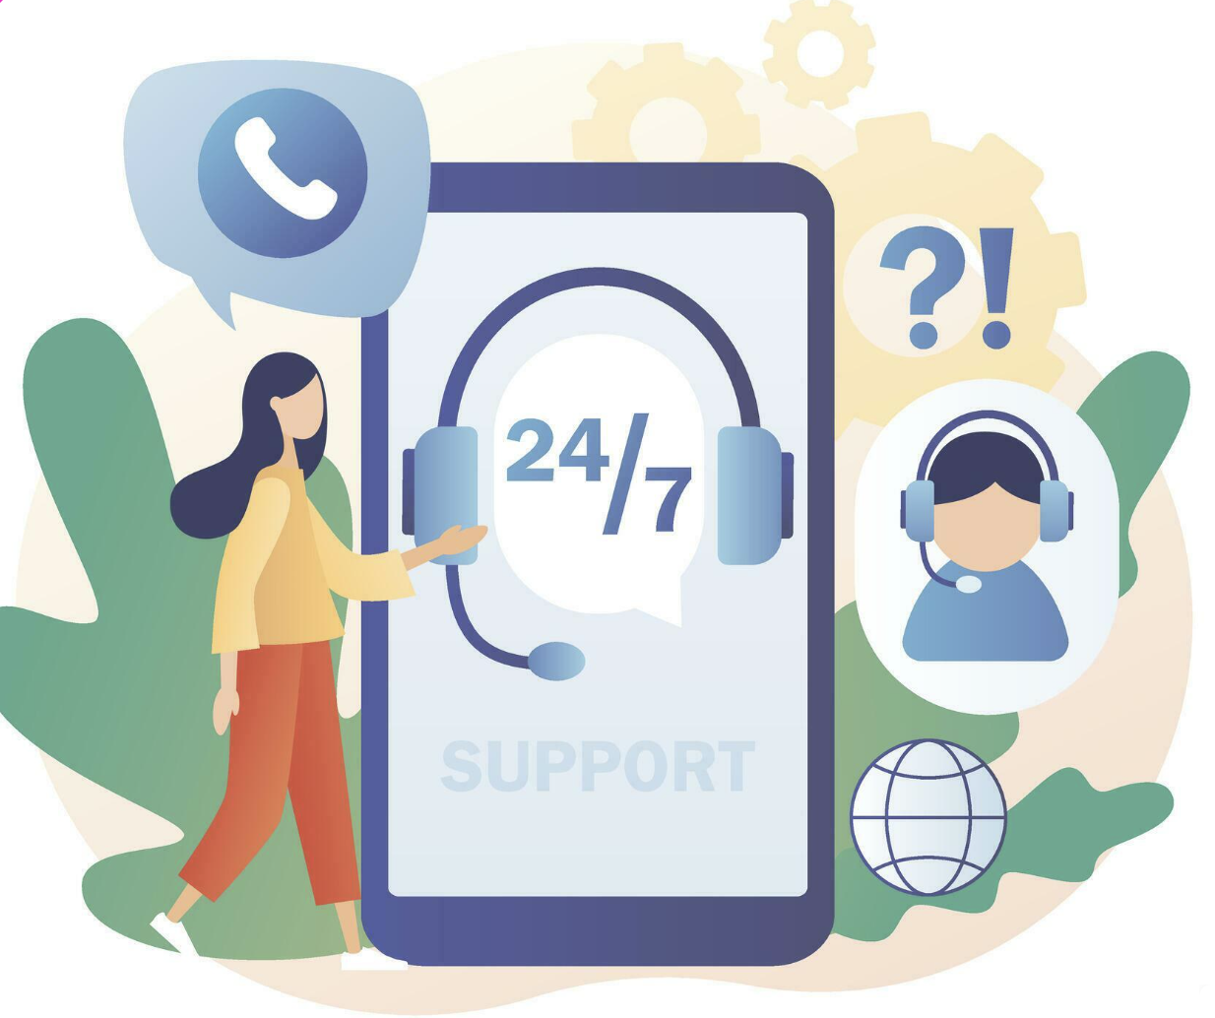
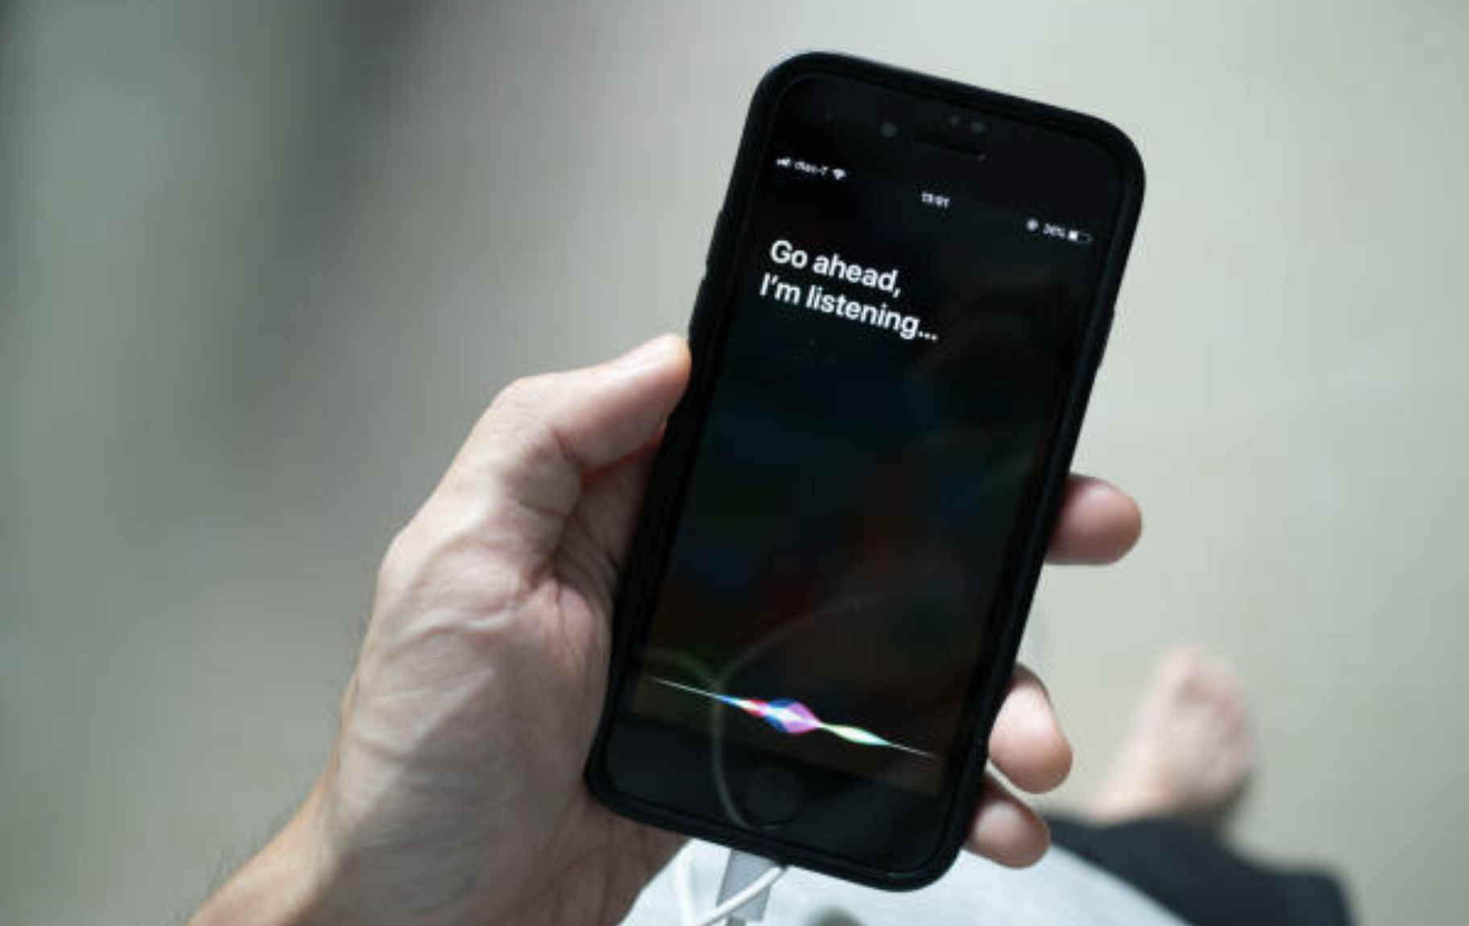
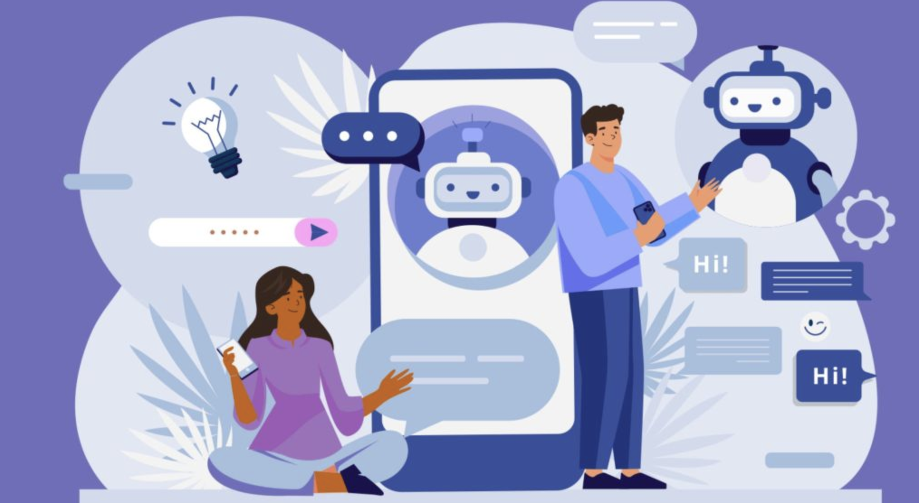
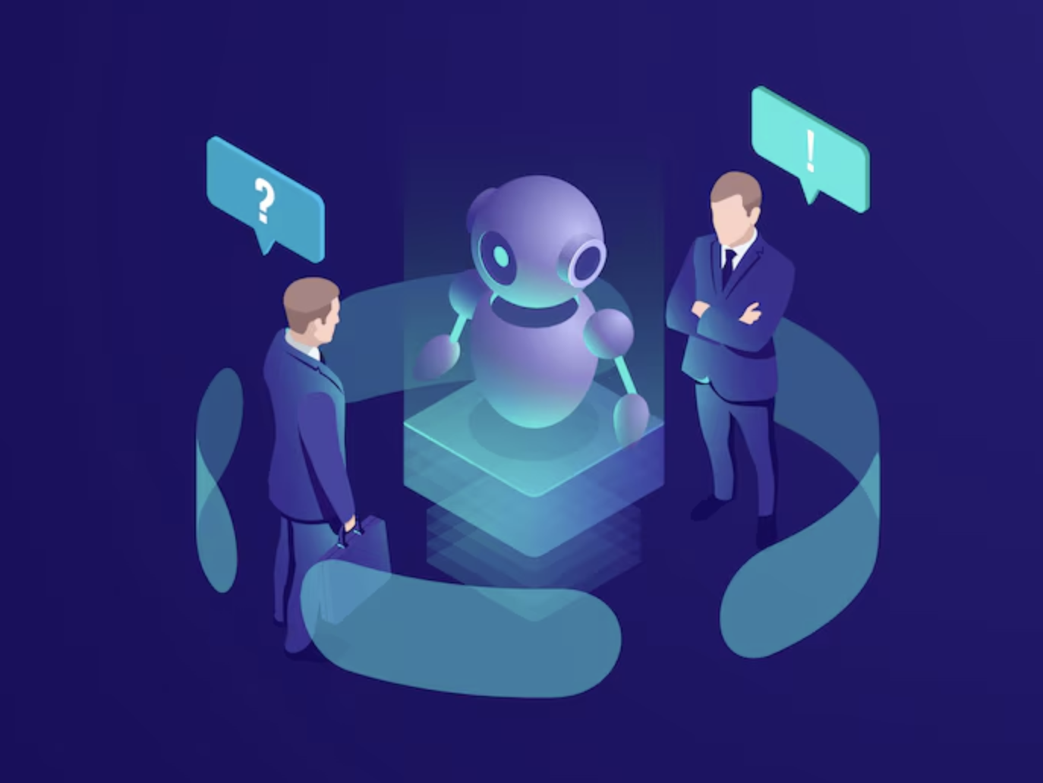
Key Advantages of AI Voice
24/7 Availability
Consistent Tone and Delivery
Scalable Support
Unbiased and Non-Manipulative

Slide 5

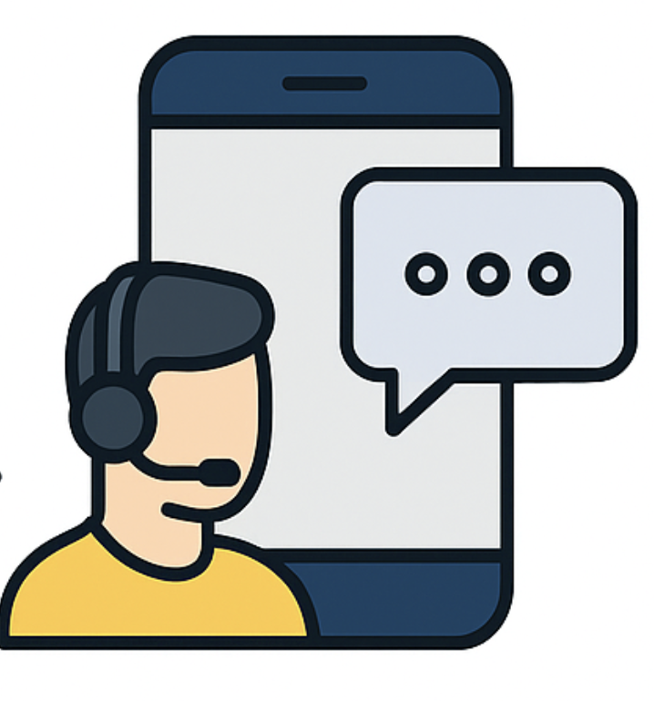


Voice Assistants in Education
Promoting Accessibility
Enhancing Real-Time Support
Reducing Administrative Load
Streamlining Learning and Engagement

Slide 6


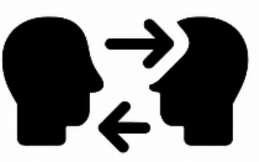

Challenges with Existing Voice Assistants in Education
Not Adaptable to University-Specific Queries
Generic, Non-Contextual Responses
Speech-to-Speech Models Are Inflexible
No Modular, Real-Time Voice Interaction Tools

Slide 7

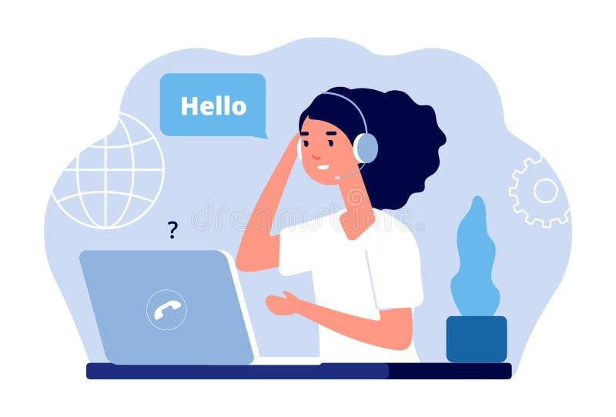
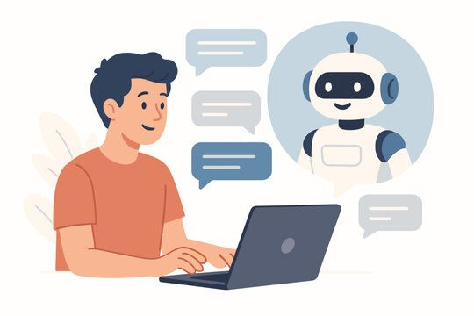
Motivation & Objective
Students Struggle to Access Academic Info Quickly
University Portals and Human Support Are Limited
Goal: Build a Modular, Real-Time, Customizable Assistant

Slide 8
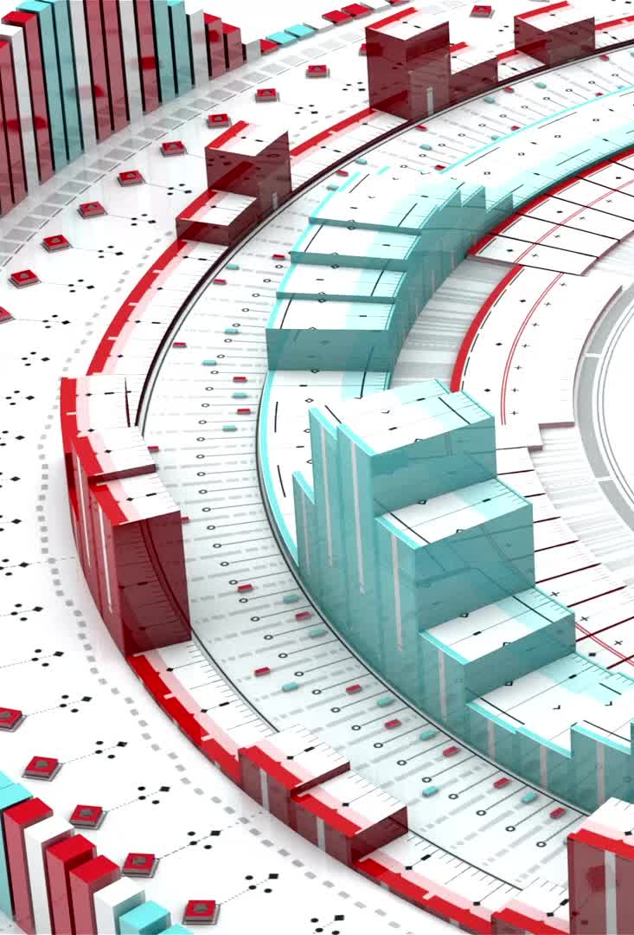
System Architecture & Model Overview

Slide 9
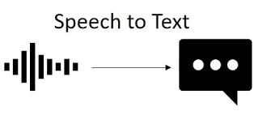
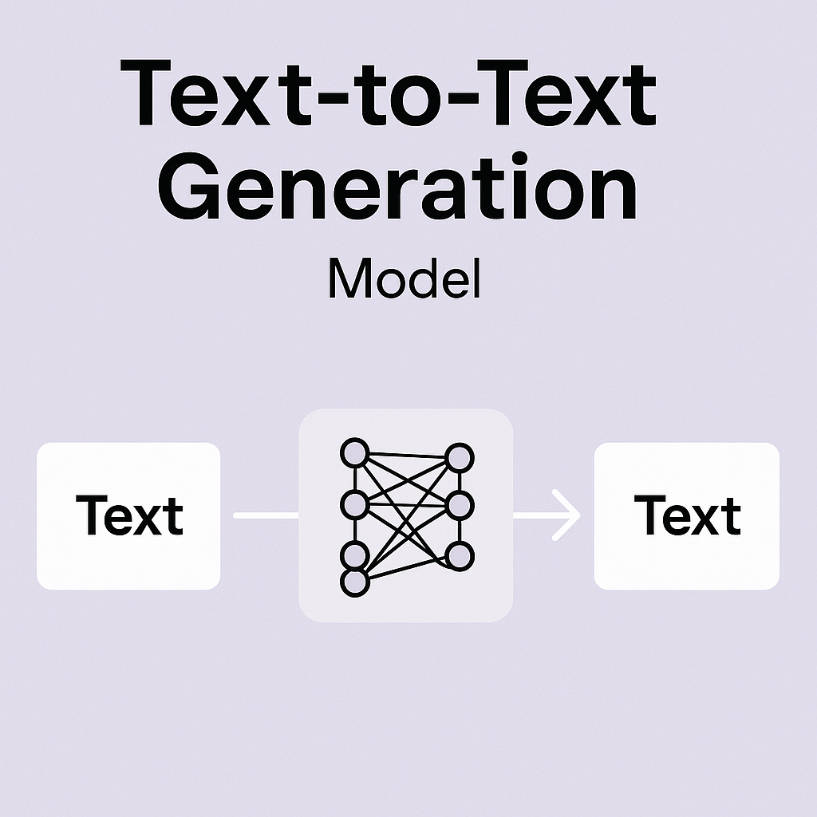
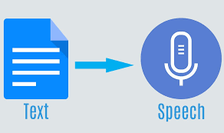
Main Components
Text to Text
Text to Speech

Slide 10



What is Speech to Text?
Converts spoken language into written text using automatic speech recognition (ASR) systems.
Used in applications like voice assistants, transcription services, and subtitles.
Powered by machine learning models trained on large audio-text datasets for high accuracy.

Slide 11



Overview of STT models
Whisper
✔️: High accuracy & multilingual (100+ languages), open-source, runs locally
❌: Heavier model; needs good GPU/CPU for real-time performance
Conformer
✔️: Optimized for real-time, cloud deployment, and scalable inference
❌: Not open-source; tied to Google ecosystem
Wav2Vec
✔️: Great accuracy even with limited labeled data (low-resource friendly)
❌: Needs fine-tuning for domain-specific use cases

Slide 12
Whisper (OpenAI)
🎙️ What is Whisper?
Open-source speech-to-text model by OpenAI
Trained on 680,000+ hours of multilingual and multitask audio
Supports 100+ languages, punctuation, timestamps, and noise robustness
Model | Speed | Accuracy | Size | Use Case
tiny / base | Fastest | Moderate | Small (~39M) | Lightweight devices, low latency
small / medium | Balanced | Good | Medium | General apps, mobile/edge use
large-v3 | Slower | Best Accuracy | Large | High accuracy, multi-language transcription
large-v3-turbo (Distilled) | Fast + Accurate | Near-large-v3 | Smaller | Real-time STT with low resource cost

Slide 13
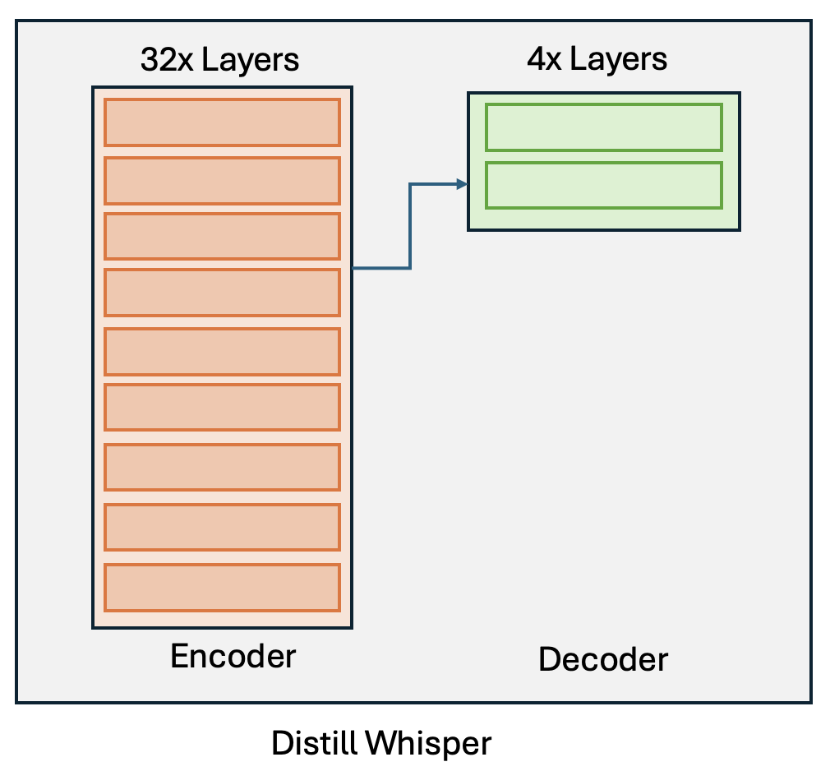
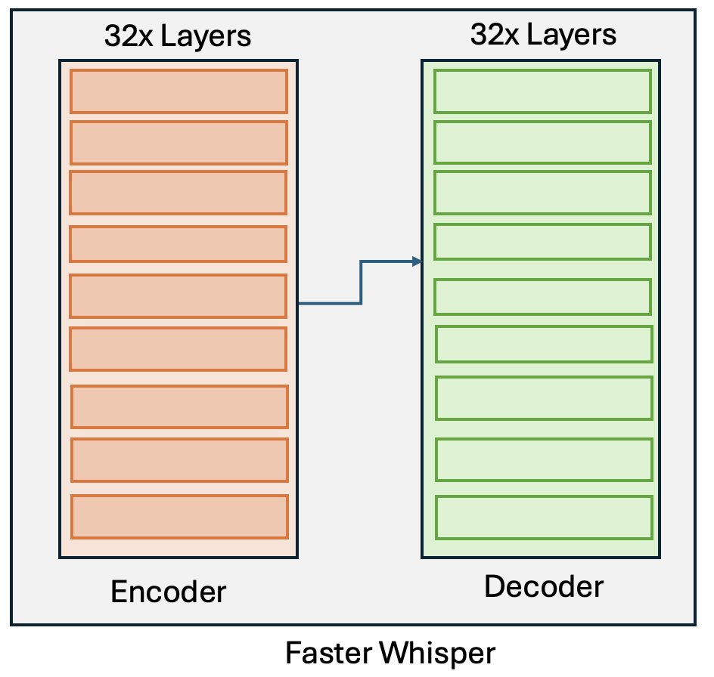
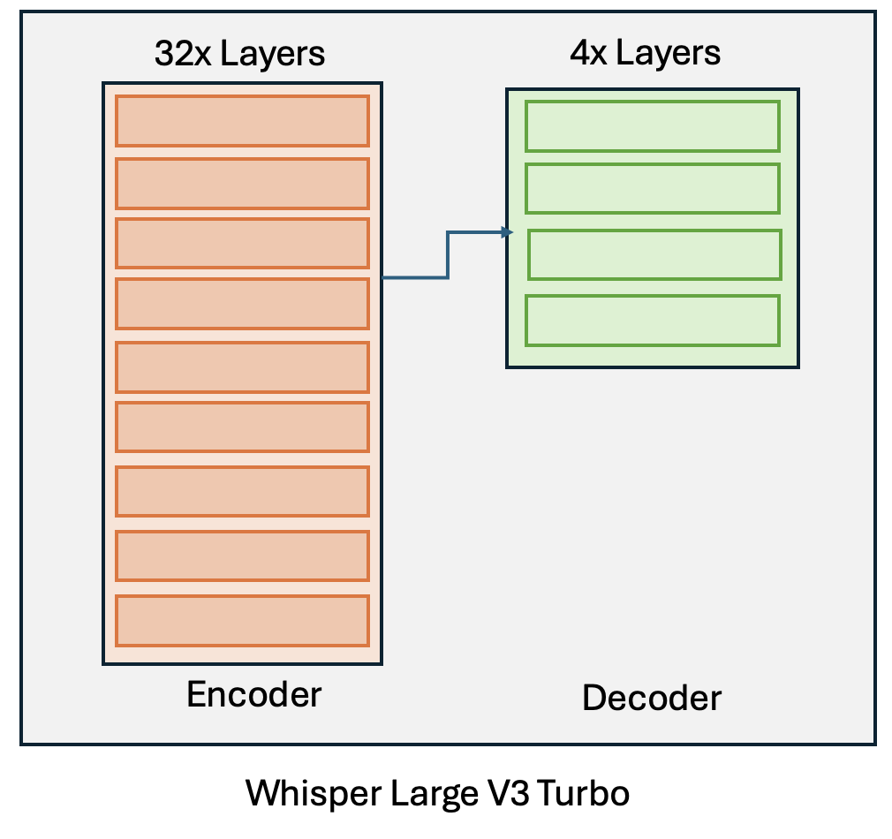
STT Whisper Comparison
2x Layers

Slide 14
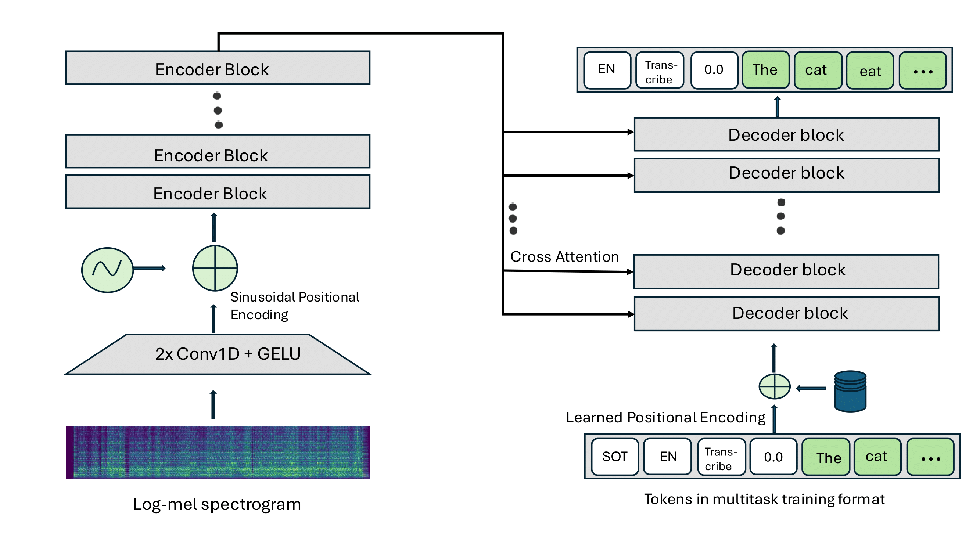
Whisper Large V3 Turbo Architecture
how to‌‍ use o‌p‌‍enai’s whisp‌‍er‌‍ fo‌r‌‍ sp‌‍eec‌h r‍ec‌o‍g‌nitio‍n

Slide 15




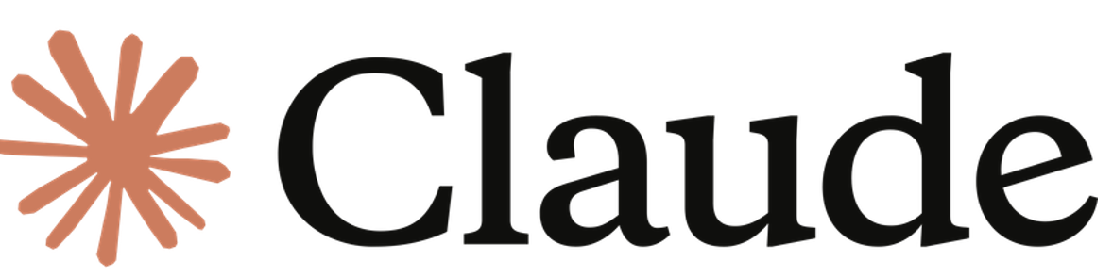

What is Text to Text?
Transforms one piece of text into another using natural language processing and large language models.
Used in applications like summarization, translation, question answering, and chatbot responses.
Driven by advanced LLMs trained on diverse datasets, context-aware text generation rewriting.

Slide 16
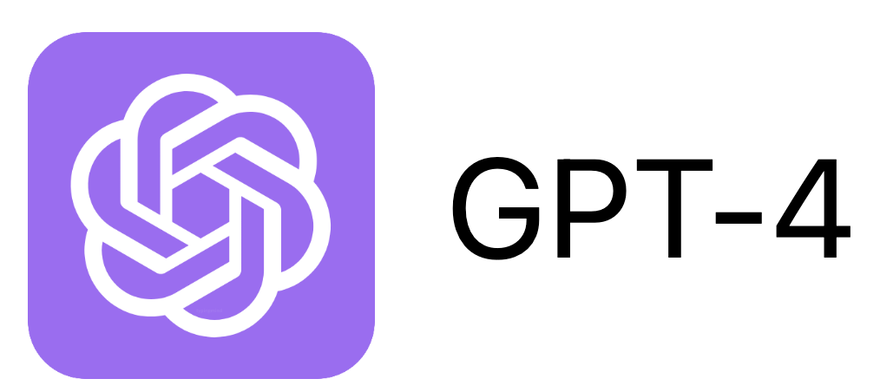


Overview of TTT Models
🔹 Highly fluent and coherent responses, great for general-purpose conversations.
🔻 Closed-source, no access to model weights, making fine-tuning.
🔹 Multi-modal model designed for the Google ecosystem, Strong integration with tools like Docs, Gmail.
🔻 Not open-source; limited flexibility for custom use cases
🔹 Open-weight, customizable, allowing domain-specific fine-tuning and offline deployment.
🔻 Requires infrastructure setup and training expertise to deploy effectively.
Meta LLaMA 3.2
OpenAI GPT-4
Google Gemini

Slide 17
LLaMA Variants and Model Selection (Meta)
Version | Sizes Available | Best For | Open-Weight | Chosen?
LLaMA 1 | 7B, 13B, 33B, 65B | Research, academic benchmarks | Yes | ❌
LLaMA 2 | 7B, 13B, 70B | Chatbots, fine-tuning, commercial apps | Yes (limited use) | ❌
LLaMA 3.0 | 8B, 70B | High-quality generation and reasoning | Yes | ❌
LLaMA 3.2 | 1B, 3B | Lightweight use, fast inference, fine-tuning | Yes | ✔️
Comparing the Llama Models

Slide 18
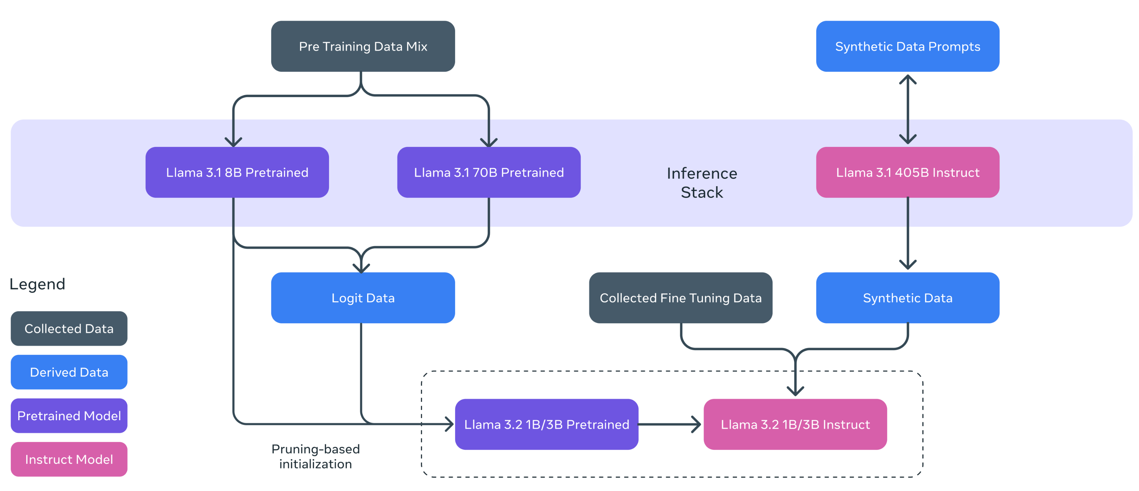

LLama 3.2B model for TTT
LLaMA 3.2B model Architecture
Llama 3.2 Lightweight model (1B & 3B) utilizes pruning and distillation
Data camp: Llama 3.2

Slide 19
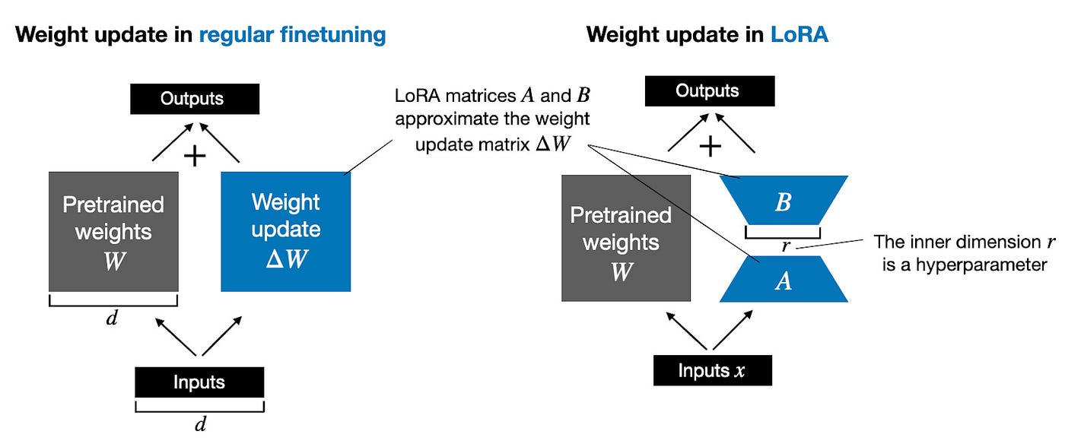
How LLaMA can be Fine-tuned?
LoRA (Low-Rank Adaptation)
W′=W + A×B
LoRA adds a low-rank update AB to frozen weights W, enabling efficient fine-tuning with minimal parameters.
Low Rank Adaptation(LoRA) in AI Models

Slide 20




What is Text to Speech?
🔊 Text-to-Speech (TTS) converts written text into spoken voice using AI-powered speech synthesis. 💬 Commonly used in voice assistants, screen readers, and accessibility tools.
Azure AI Speech text-to-speech Feb 2025 updates
Introducing Eleven v3 (alpha)
Amazon Polly - AI Voice Generator
Text-to-Speech AI

Slide 21

TTS model Comparison
LLassa-3B by HKUST Audio
Large, multilingual TTS built on LLaMA architecture
Trained on 250k+ hrs. of Chinese-English audio
Supports TTS + voice prompting workflows
Needs 13–18 GB VRAM; best for cloud/server deployment
Languages: Chinese & English only
F5-TTS by Swivid
High-fidelity TTS using flow-matching + diffusion
Zero-shot voice cloning with just 10 seconds of speech
Multilingual, expressive output with 6–8 GB VRAM
Real-time capable (~0.15 RTF)
Not suitable for mobile/edge devices
F5-TTS model and features
LLaSA-3B: A Llama 3.2B Fine-Tuned Text-to-Speech Model

Slide 22

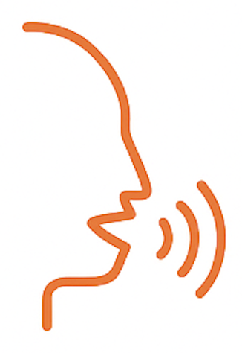




Features of Kokoro 82M model
Lightweight Architecture
Multilingual Support
Natural & Expressive Speech
Customizable Voicepacks
OpenAI-Compatible Speech Endpoint
Real-Time Audio Generation
Kokoro TTS
Kokoro-82M

Slide 23

Implementation

Slide 24
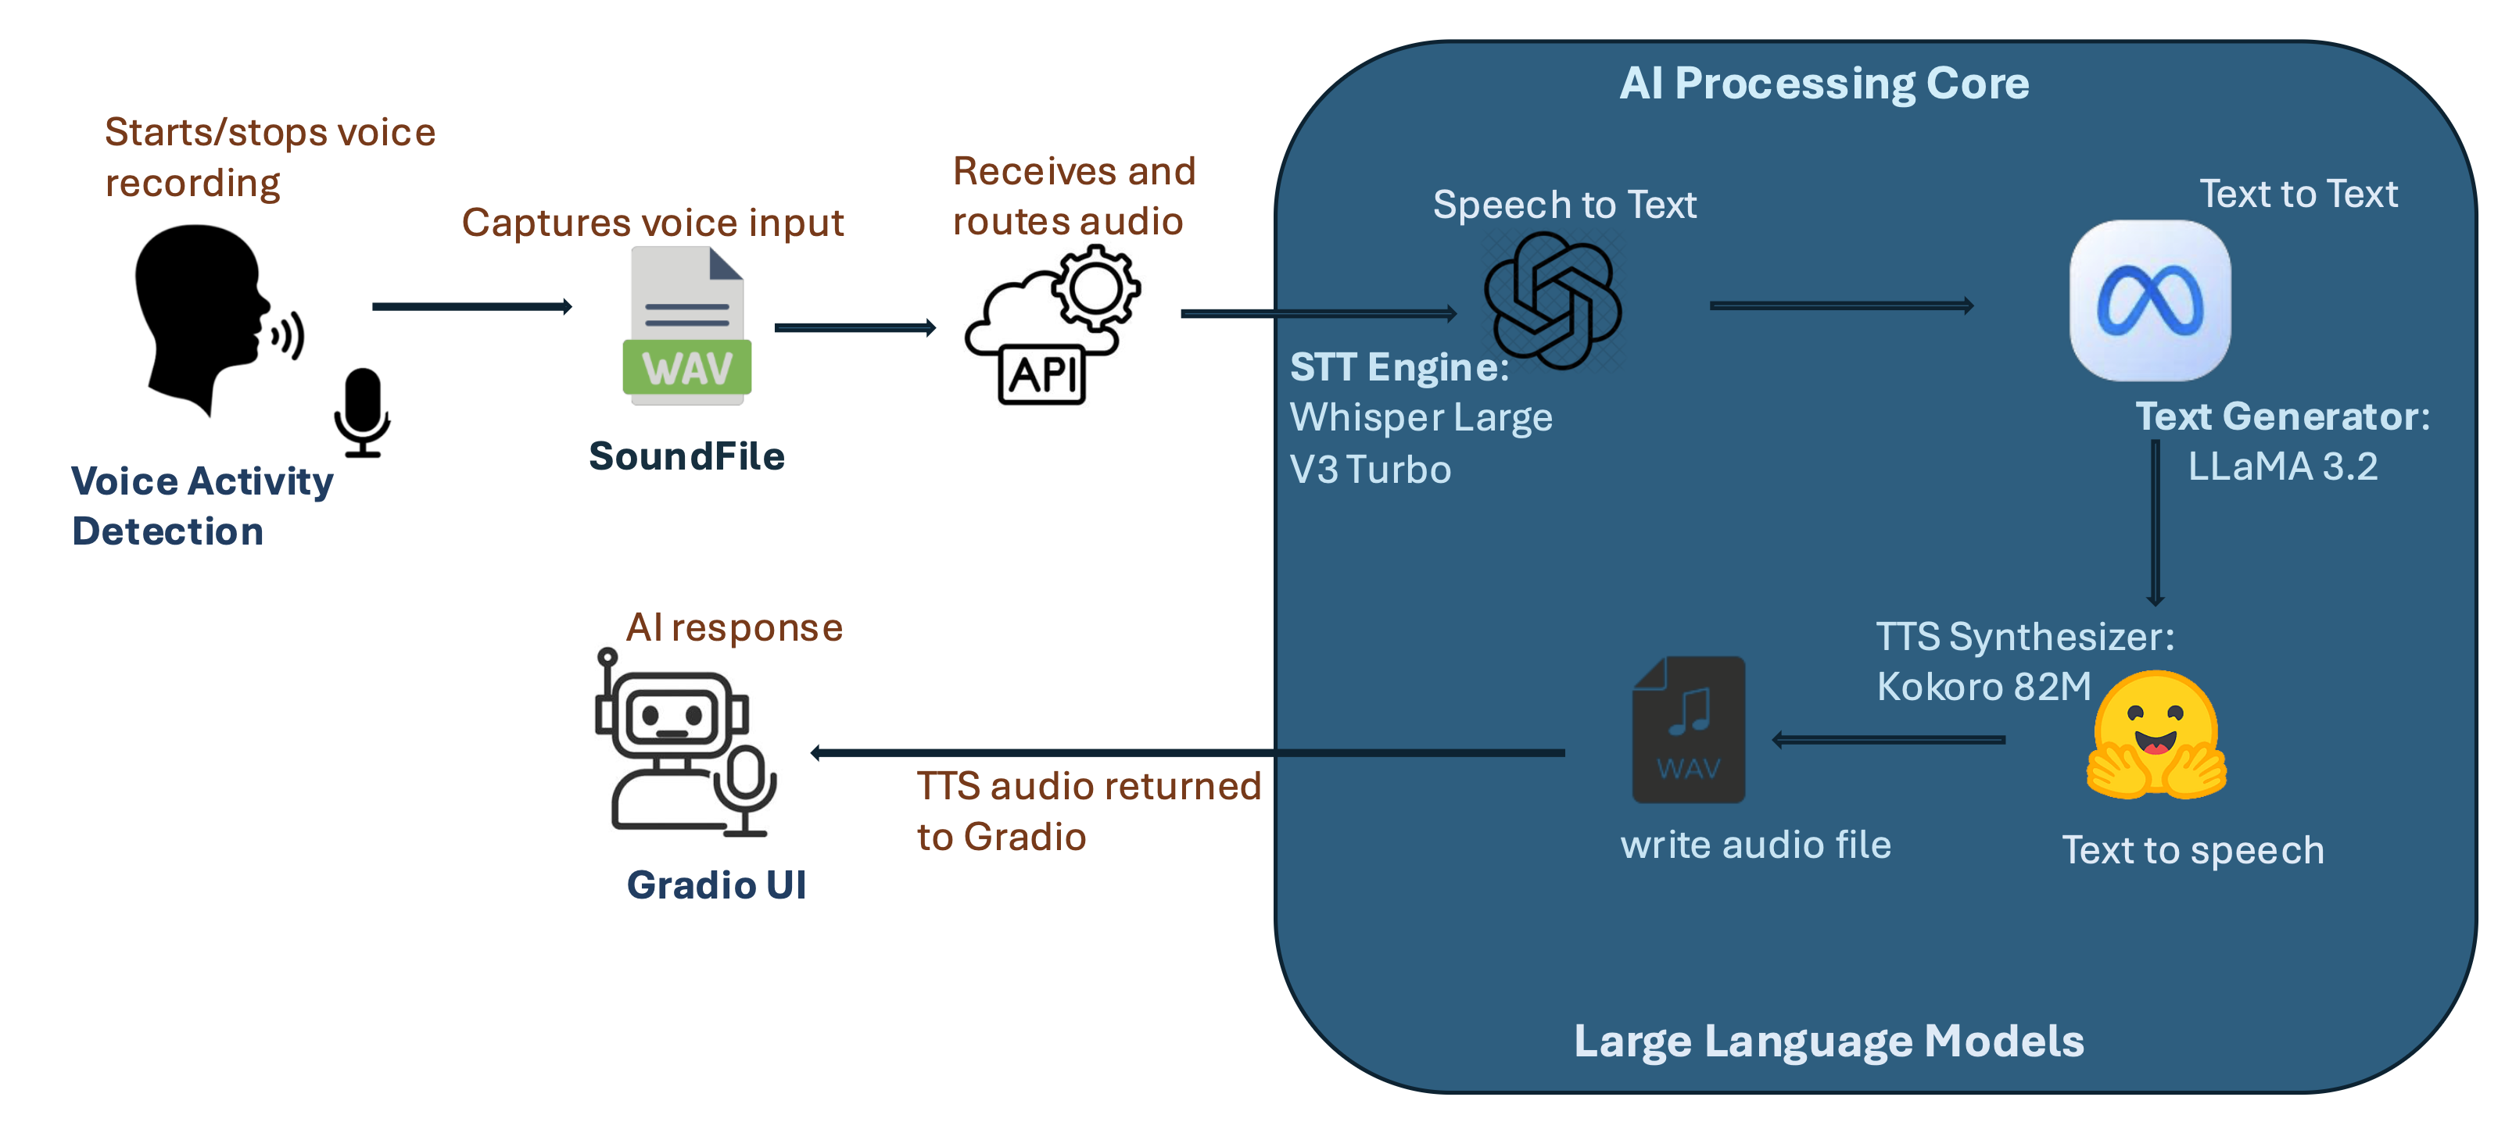
End-to-End Pipeline

Slide 25
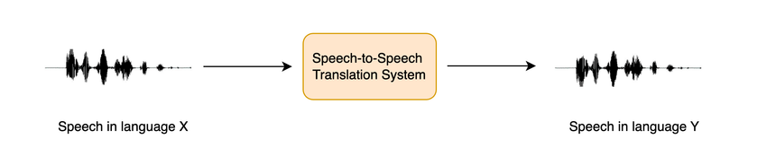


Why not Speech-to-Speech?
S2S models offer a seamless pipeline from input speech to output speech, with no manual stitching.
Low Customization
Lack of Control
SeamlessM4T (Meta AI): Multilingual and multitask speech-to-speech model VALLE (Microsoft Research): Zero-shot speech synthesis and continuation with neural codec language models

Slide 26




Dataset Creation & Preprocessing Algorithm
Algorithm 1 Data Preparation and Synthesis using GPT-3.5-Turbo
1: # Load environment variables and API key
2: load_dotenv(), set openai.api_key
3: # Load and preprocess source document
4: text ←PyPDFLoader(file).load()
5: chunks ←RecursiveCharacterTextSplitter().split(text)
6: for each chunk in chunks do
7: # Generate Q&A pairs using GPT-3.5
8: prompt ←formatted instruction with JSON schema
9: response ←openai.ChatCompletion.create(prompt)
10: parsed ←json.loads(clean(response))
11: all_conversations.append(parsed)
12: end for
13: # Save synthesized dataset
14: json.dump(all_conversations, “faq_dataset.json”)
15: write_to_file(“faq_dataset.txt”, all_conversations)
Web Data Extraction
Chunking Logic
Validation & Aggregation
LLM-Based Formatting

Slide 27





Real-time Streaming & VAD Trigger
Enabling Hands-Free, Natural Voice Interaction in the Browser
Algorithm 2 JavaScript VAD Trigger
1: # Load required scripts
2: script1 ←onnxruntime-web
3: script2 ←vad-web
4: Append script1 to HTML head
5: On script1.onload: Append script2
6: On script2.onload: Initialize MicVAD with callbacks
7: # Define callbacks
8: onSpeechStart(): Trigger record.click() to start audio
9: onSpeechEnd(audio): Trigger stop.click() to stop audio
10: # Start VAD monitoring
11: myvad.start()
Mic Access
VAD Detection
Gradio Trigger
Silence Detected
UI Response

Slide 28







SFT-Trainer Configuration
Fine-Tuning LLaMA 3.2B with LoRA + Unsloth
Algorithm 2 Trainer and Fine-Tuning Configuration
1: # Set up trainer configuration
2: Define training arguments:
3: num_train_epochs ←20
4: per_device_train_batch_size ←2
5: gradient_accumulation_steps ←4
6: learning_rate ←2e−4
7: lr_scheduler_type ←"linear"
8: optim ←"adamw_8bit"
9: logging_steps ←1
Algorithm 2 Trainer and Fine-Tuning Configuration
10: fp16 ←True or False (based on hardware)
11: output_dir ←"outputs/"
12: # Initialize SFTTrainer
13: trainer ←SFTTrainer(model, tokenizer, dataset, args)
14: # Focus on assistant responses
15: trainer ←train_on_responses_only(trainer)
16: # Start fine-tuning
17: trainer.train()
LoRA Applied
4-bit Quantization
Response
Focused
20 Epochs + 8-bit AdamW
SFT Trainer
Academic Dataset
Model and tokenizer uploaded to Hugging Face Hub

Slide 29

Results & Evaluation

Slide 30
Evaluation Metrics Llama model
F1- Score – 0.59
Example:
Reference: “Bring the form to DION 326.”
Bot: “Submit your form to the DION office.”
Here, F1 gives credit for matching words like “form”, “DION”, and “submit”, even if the sentence is phrased differently.
BLEU – 0.6
Example:
Reference: “Check COIN for your advisor’s name.”
Bot: “Look in COIN for your advisor.”
BLEU looks at word matches like “COIN”, “advisor”, and small word pairs like “your advisor”.

Slide 31
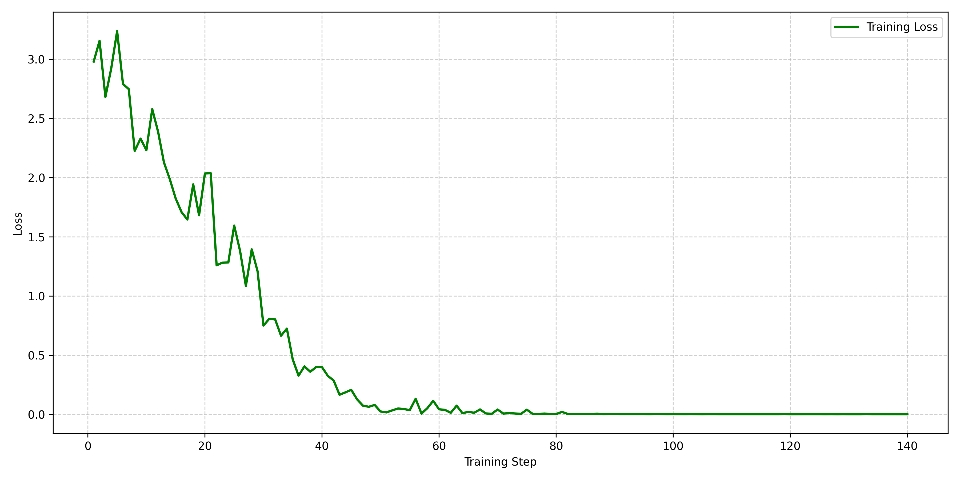
Training Convergence

Slide 32
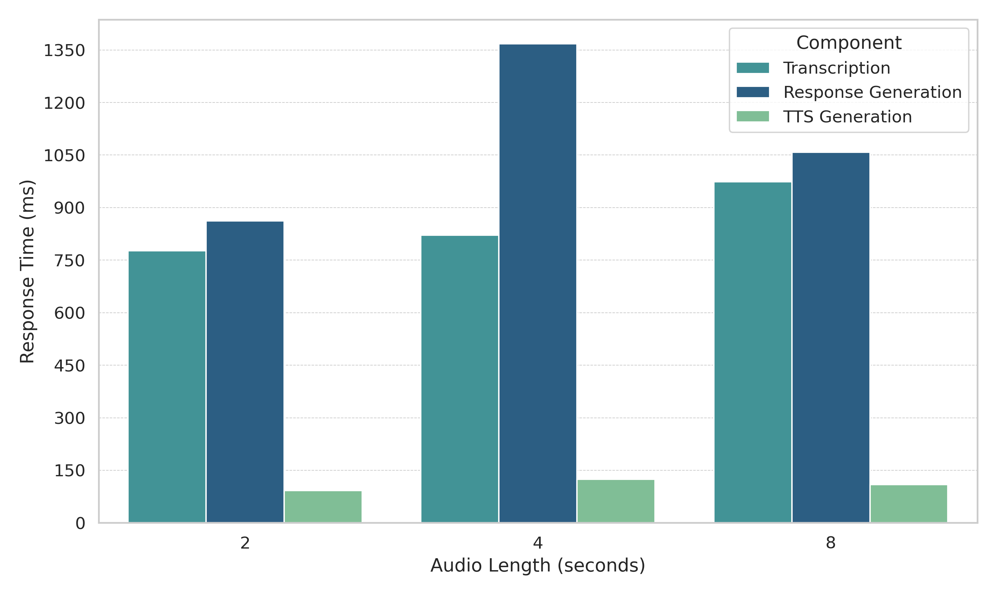
Latency Evaluation Across Audio Durations

Slide 33
TTS Model Evaluation Results
Despite lacking fine-tuning, Kokoro-82M achieved real-time performance with a minimal footprint (820MB), outperforming larger models in deployment readiness.
Model | Speed (s) | Model Size | Consistent Output | Supports Fine-tuning
Kokoro-82M | 1.00 | Small (820MB) | Yes | No
StyleTTS 2 | 1.10 | Medium | Yes | Yes
F5 TTS | 7.16 | Big (40GB) | Yes | Yes
FastPitch | 0.75 | Big (50GB) | Yes | No
Zonos | 205.00 | Medium | Yes | Yes

Slide 34
TTS Model Evaluation Results: Quality and Voice Capabilities
While other models offer voice cloning, Kokoro-82M balances clarity and multi-voice support in a smaller, faster, and more integration-friendly package.
Model | Clarity (1–5) | Pronunciation (1–5) | Voice Cloning | Multiple Voices
Kokoro-82M | 4 | 3 | No | Yes
StyleTTS 2 | 3 | 3 | Yes | Yes
F5 TTS | 4 | 4 | Yes | Yes
FastPitch | 3 | 4 | No | No

Slide 35


GPU Profiling & Latency
Kokoro TTS delivers the lowest latency (332.9 ms) and GPU usage (13%, 1.91 GB), ideal for real-time use.
LLaMA 3.2B has the highest latency (1657 ms) and GPU load (83%, 4.57 GB), suited for offline tasks.
Model | Latency (ms) | GPU Utilization (%) | VRAM Used (GB)
Whisper | 523.0 | 55% | 2.89
LLaMA 3.2B | 1657.0 | 83% | 4.57
Kokoro TTS | 332.9 | 13% | 1.91

Slide 36
Model comparison with Ground Truth
Question | Ground Truth | LLaMA 3.2 Fine-Tuned Response
Who is my academic advisor? | Log into myUMassD and check COIN for your advisor’s name. If it’s not listed, contact your major department. Undecided engineering students should also contact the department for advisor information. | You can find your advisor’s name by logging into COIN via myUMassD. If no advisor is listed, contact your major department directly. Undecided engineering students should also contact the department for advisor details.
What should I do if there’s a registration hold in COIN preventing me from enrolling in courses? | Check your Student Center in COIN to identify the hold type. Advising holds require meeting your advisor, financial holds go through the Bursar, immunization holds through Health Services, and some (like emergency contacts) you can resolve yourself. | Check your Student Center in COIN to see the type of hold. If it’s an Advising hold, meet with your advisor. Financial holds must be cleared with the Bursar’s Office, and Immunization holds with Health Services. Some holds, like Emergency Contact updates, can be resolved by the student directly.
How do I get the Dean’s signature on forms? | Submit your forms to the College of Engineering Dean’s Office in DION 326. The Associate Dean handles all signatures. Allow a few business days, so don’t wait until the last minute. | Bring your forms to the College of Engineering Dean’s Office in DION 326. The Associate Dean for Academic Affairs signs all paperwork. Allow a few business days for processing, don’t wait until the last minute.
What is my campus address for receiving mail? | To receive mail on campus, use: MacLean Campus Center, University of Massachusetts Dartmouth, 285 Old Westport Road, Dartmouth, MA 02747. Avoid labeling it as a P.O. Box to prevent postal delays. | To receive mail on campus, use this address: MacLean Campus Center, University of Massachusetts Dartmouth, 285 Old Westport Road, Dartmouth, Massachusetts, 02747. Be sure not to label it as a P.O. Box, or it may be delayed by P.O.
What are the enrollment rules for international students? | International students must register for at least 9 credits per term. If it’s your final semester, submit a Reduced Course Load form through the ISSC portal. | International students must enroll in at least 9 credits per semester. In final semester, students must submit a Reduced Course Load form via the ISSC website.

Slide 37

Future Work & Conclusion

Slide 38
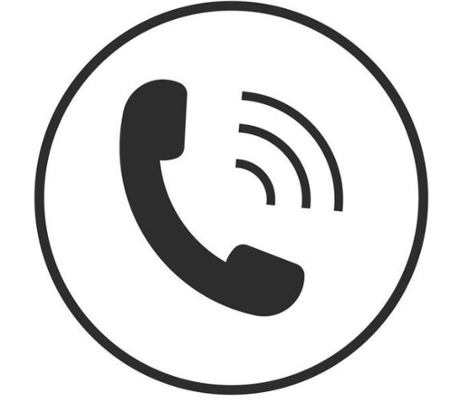


Next Steps for Enhancement
Phone Call Integration via Twilio
Cloud-Native & Serverless Deployment
End-to-End Data Privacy

Slide 39



Vision Ahead
Campus Health Assistant
Smart Academic Calendar Assistant
24/7 Student Helpdesk Chatbot

Slide 40
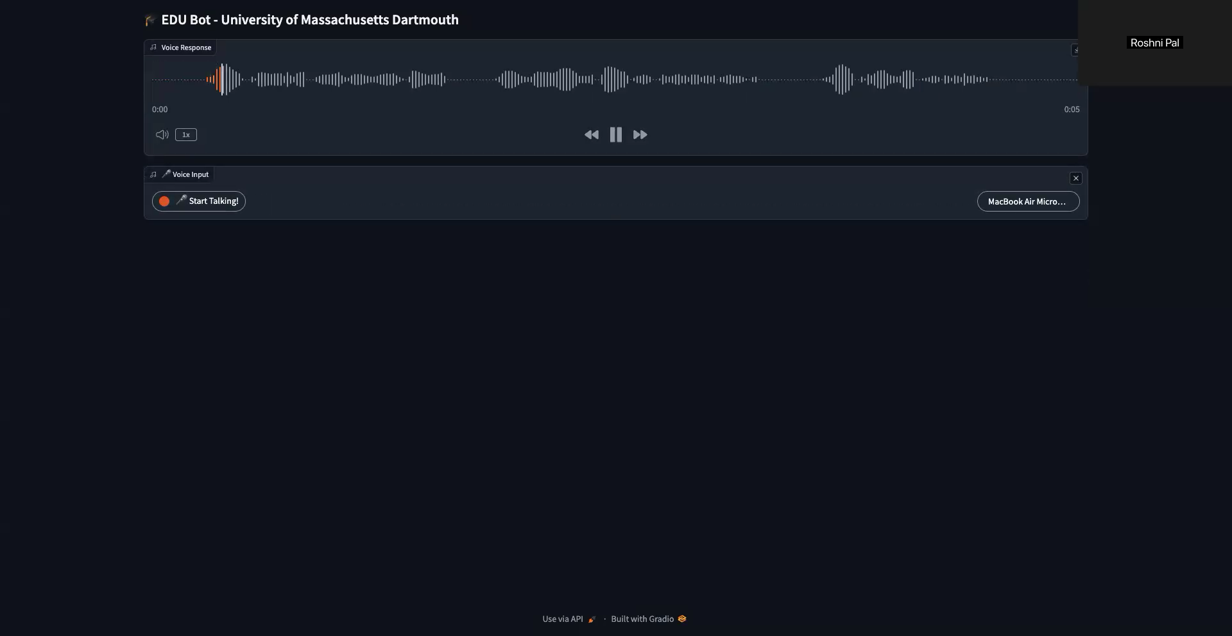
Application Demo

Slide 41
References
Chen, Yushen, Niu, Zhikang, Ma, Ziyang, Deng, Keqi, Wang, Chunhui, Zhao, Jian, Yu, Kai, and Chen, Xie. F5-TTS: A Fairytaler that Fakes Fluent and Faithful Speech with Flow Matching. arXiv preprint arXiv:2410.06885, 2024. https://doi.org/10.48550/arXiv.2410.06885.
Li, Yinghao Aaron, Han, Cong, Raghavan, Vinay S., Mischler, Gavin, and Mesgarani, Nima. StyleTTS 2: Towards Human-Level Text-to-Speech through Style Diffusion and Adversarial Training with Large Speech Language Models. arXiv preprint arXiv:2306.07691, 2023. https://doi.org/10.48550/arXiv.2306.07691.
Kaneko, Takuhiro, Tanaka, Kou, Kameoka, Hirokazu, and Seki, Shogo. iSTFT-Net: Fast and Lightweight Mel-Spectrogram Vocoder Incorporating Inverse Short-Time Fourier Transform. arXiv preprint arXiv:2203.02395, 2022. https://doi.org/10.48550/arXiv.2203.02395.
Hexgrad. Kokoro-82M (Revision d8b4fc7). Hugging Face, 2025. DOI: https://doi.org/10.57967/hf/4329.
Radford, Alec, Kim, Jong Wook, Xu, Tao, Brockman, Greg, McLeavey, Christine, and Sutskever, Ilya. Robust Speech Recognition via Large-Scale Weak Supervision. arXiv preprint arXiv:2212.04356, 2022. https://doi.org/10.48550/arXiv.2212.04356.

Slide 42
Acknowledgement
I would like to express my deepest gratitude to all those who have supported and guided me throughout my master’s journey.
Advisor: Dr. Long Jiao
Committee Members: Dr. Ashokkumar Patel, Dr. Yuchou Chang
Program Director: Dr. Ashokkumar Patel
Chairperson: Dr. Haiping Xu
Friends and Family Members: Your support has been invaluable.
Audience: Thank you for your attention and interest.

Slide 43
Q & A Session
THANK YOU!
Open to Questions

